Slide 1
Summary and Critique of; Neutronics and fuel performance evaluation of accident tolerant FeCrAl Cladding under normal operation conditions
NE533, Feb. 15, 2022

Slide 2
Contents
Why?
Thermal-Physical Properties.
Neutronic Analysis.
Fuel Performance Analysis.

Slide 3
Why?
ATF Cladding Concepts
SiC
Coated Zirconium Alloys.
FeCrAl ALLoy.
Fukushima Nuclear Accident
Post Accident Investigation
Zircaloy Oxidation and Hydrogen Production
Need to replace Zirconium based alloys with ATF cladding.

Slide 4
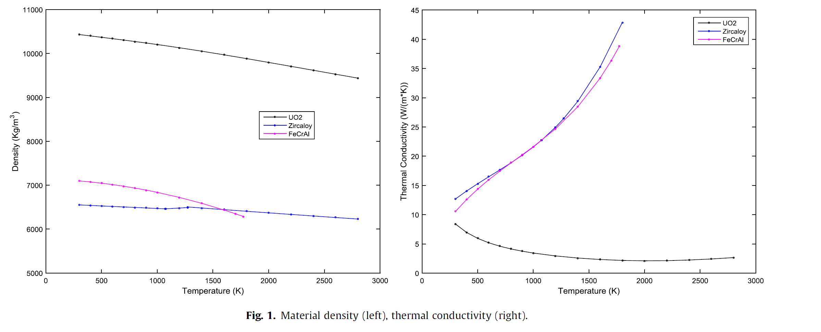
Thermal-Physical Properties.

Slide 5
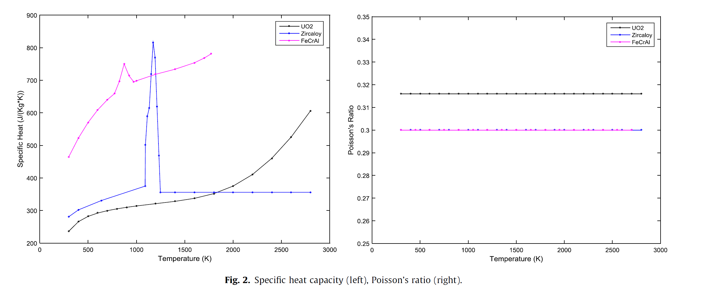
Thermal-Physical Properties.

Slide 6
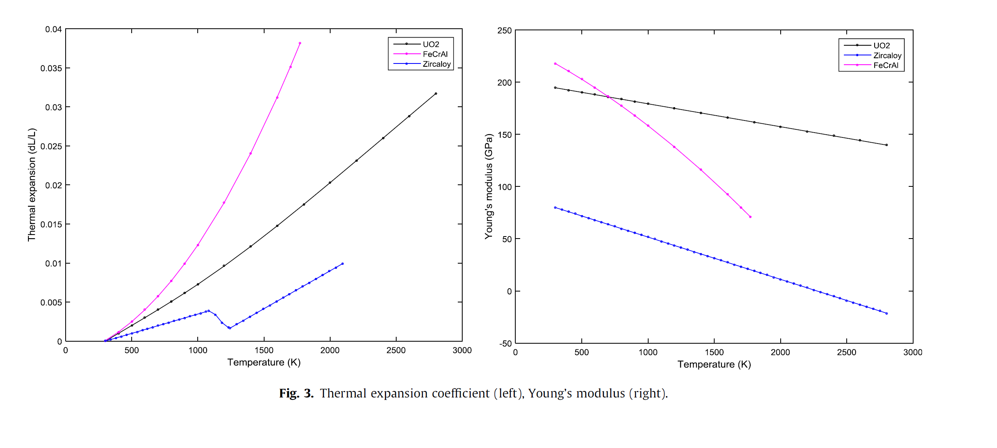
Thermal-Physical Properties.

Slide 7
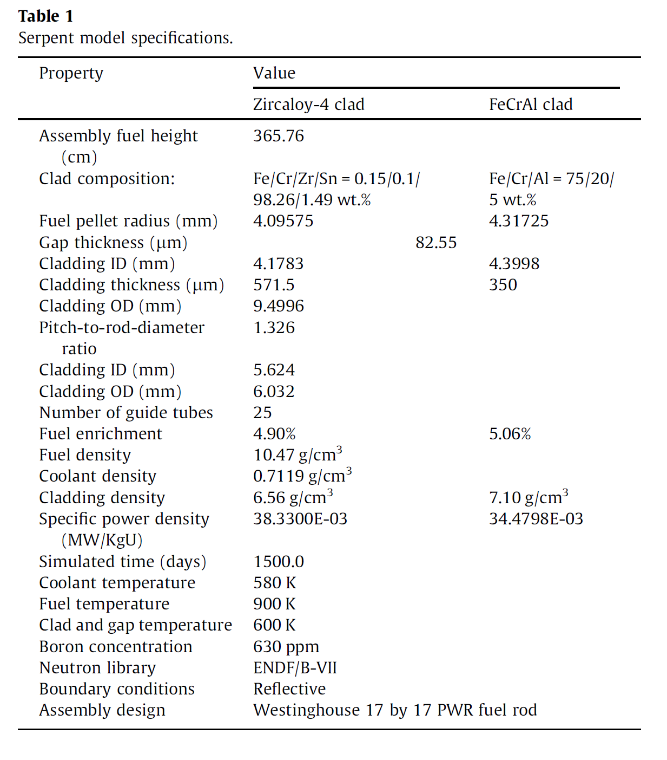
Neutronic Analysis.
To confirm results reported by George et al (2015).
George et al (2015) used SCALE/TRITON.
Optimized design, (Terrani et al., 2013).
Higher strength allow reduction in thickness.
Increase enrichment by 0.16% to meet life time requirements.
Critique.

Slide 8
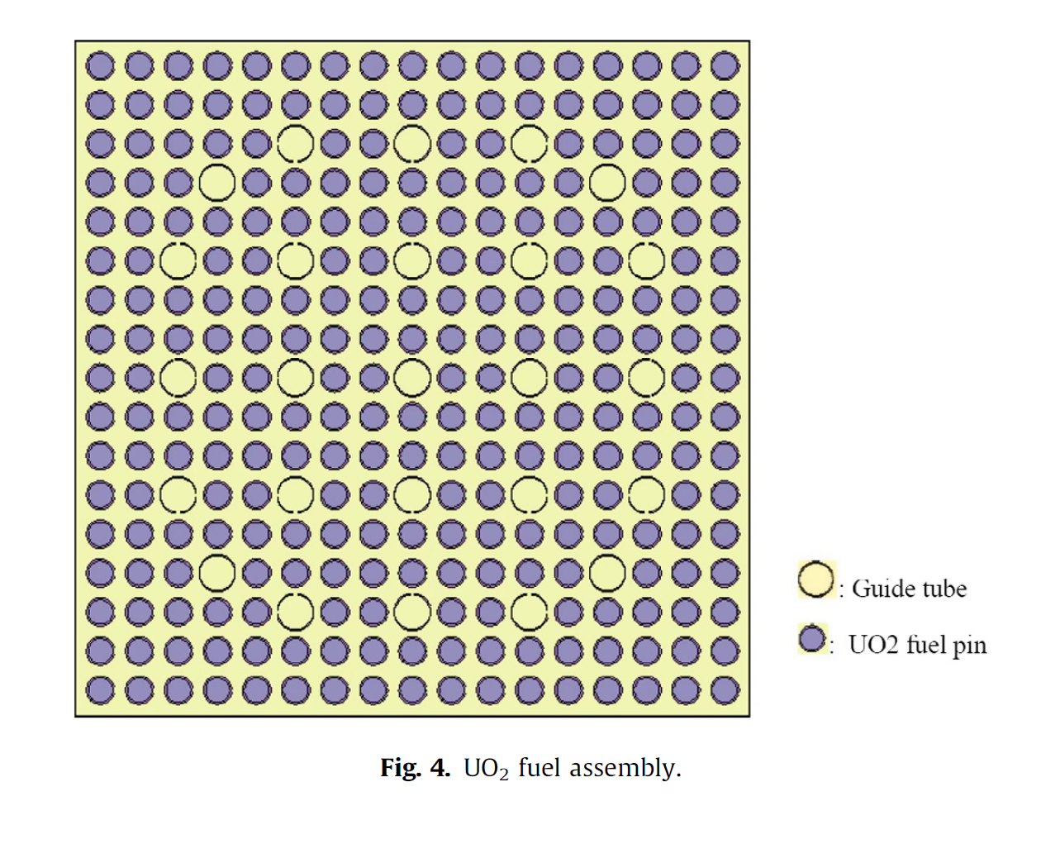
Neutronic Analysis Model.
PWR single assembly based on Westinghouse design.
17*17 grid.
264 fuel pin.
25 guide tube.

Slide 9
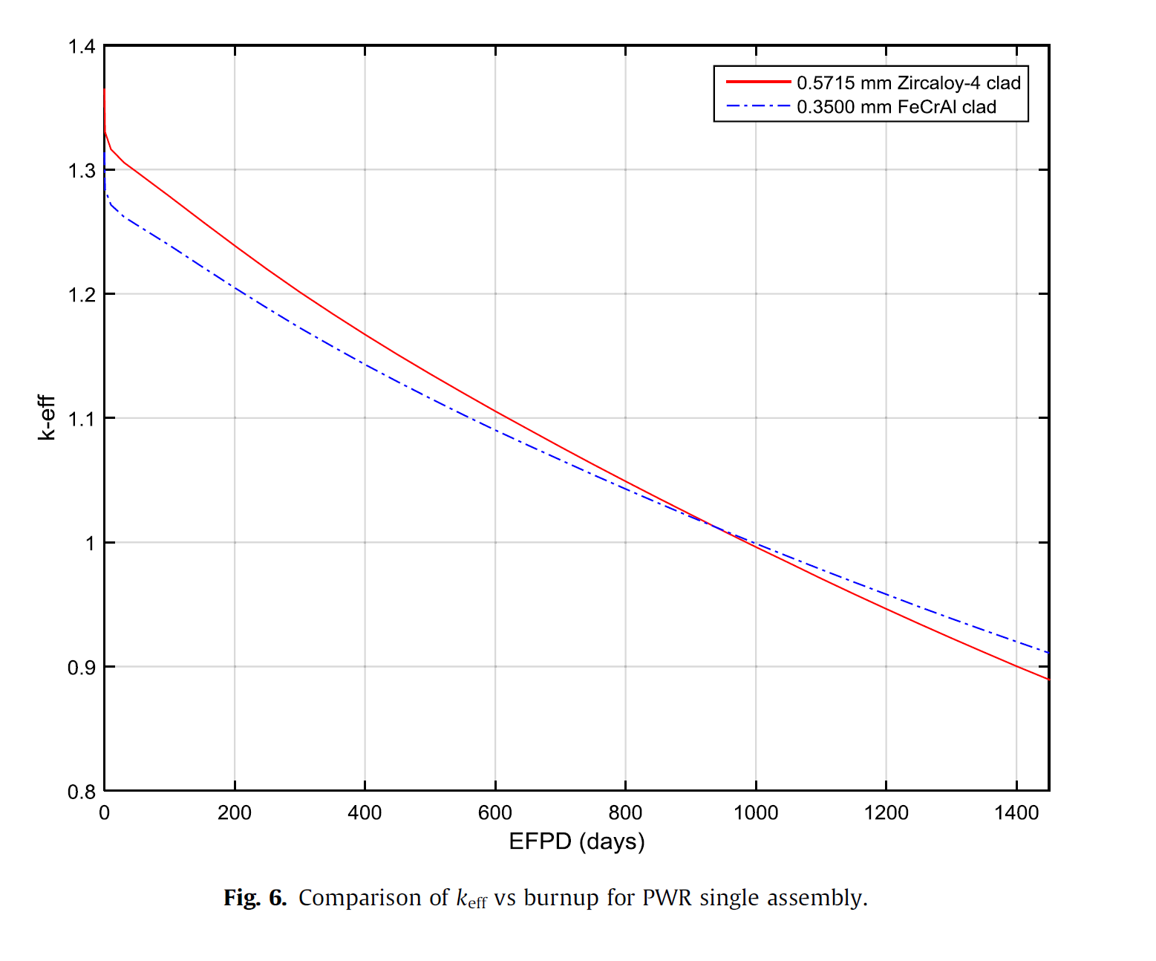
Neutronic Analysis.
The suggested design is able to maintain the PWR cycle length.
At the depletion region, increase of reactivity with FeCrAl.
Accumulation of Pu at the EOL.
Critique.

Slide 10
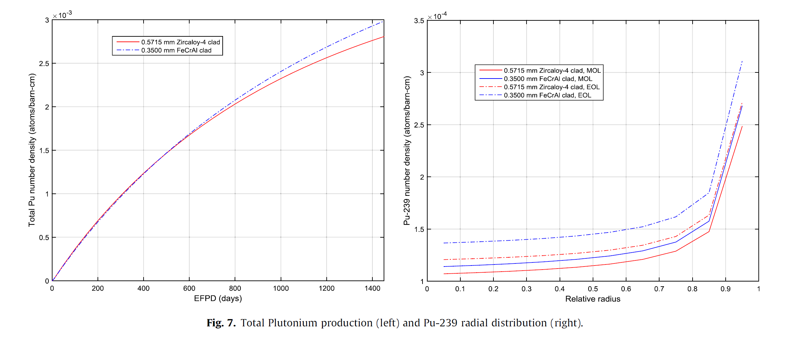
Neutronic Analysis.
Pu will accumulate in the periphery.
Spatial self-shielding of neutrons.
Rim effects.
This is due to harder neutron spectrum.

Slide 11
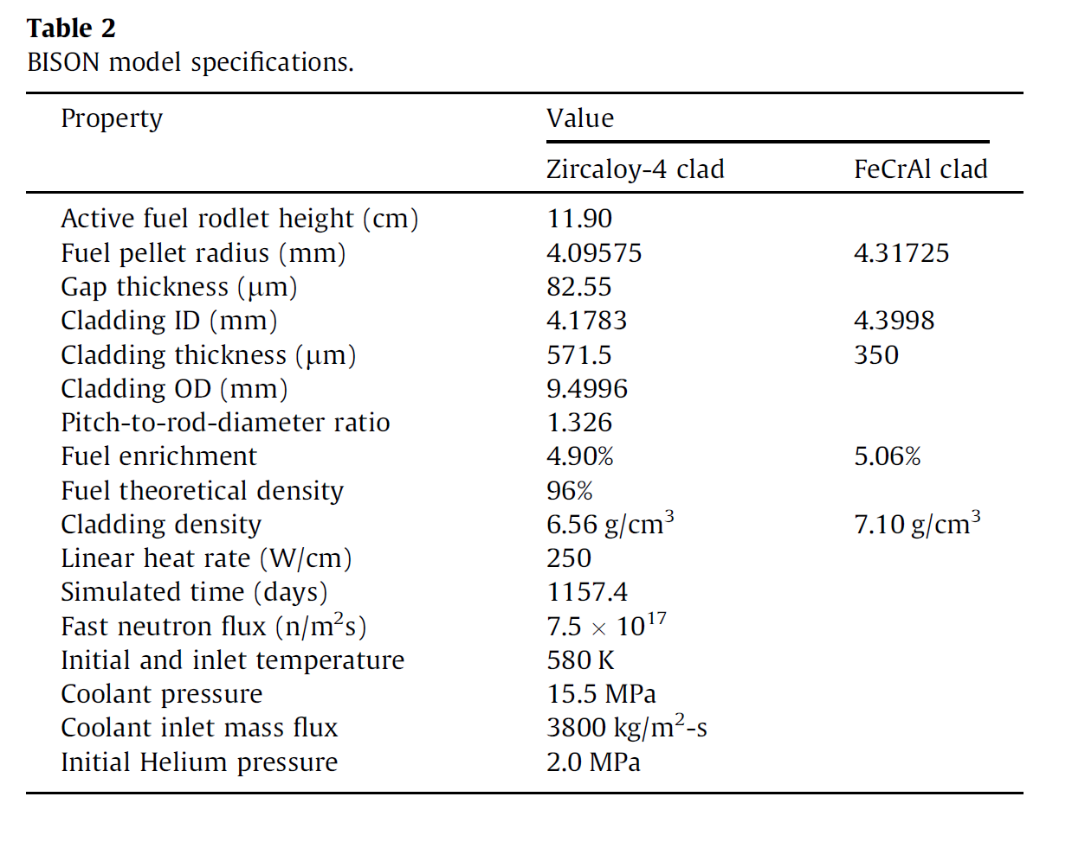
Fuel Performance Analysis.
BISON is used to model LWR nuclear fuel pin.
Oxidation rates are set to 0 for FeCrAl.
Thermal or irradiation creep for FeCrAl is currently not available.
Simulation time 3.2 y.
Uniform convective boundary.

Slide 12
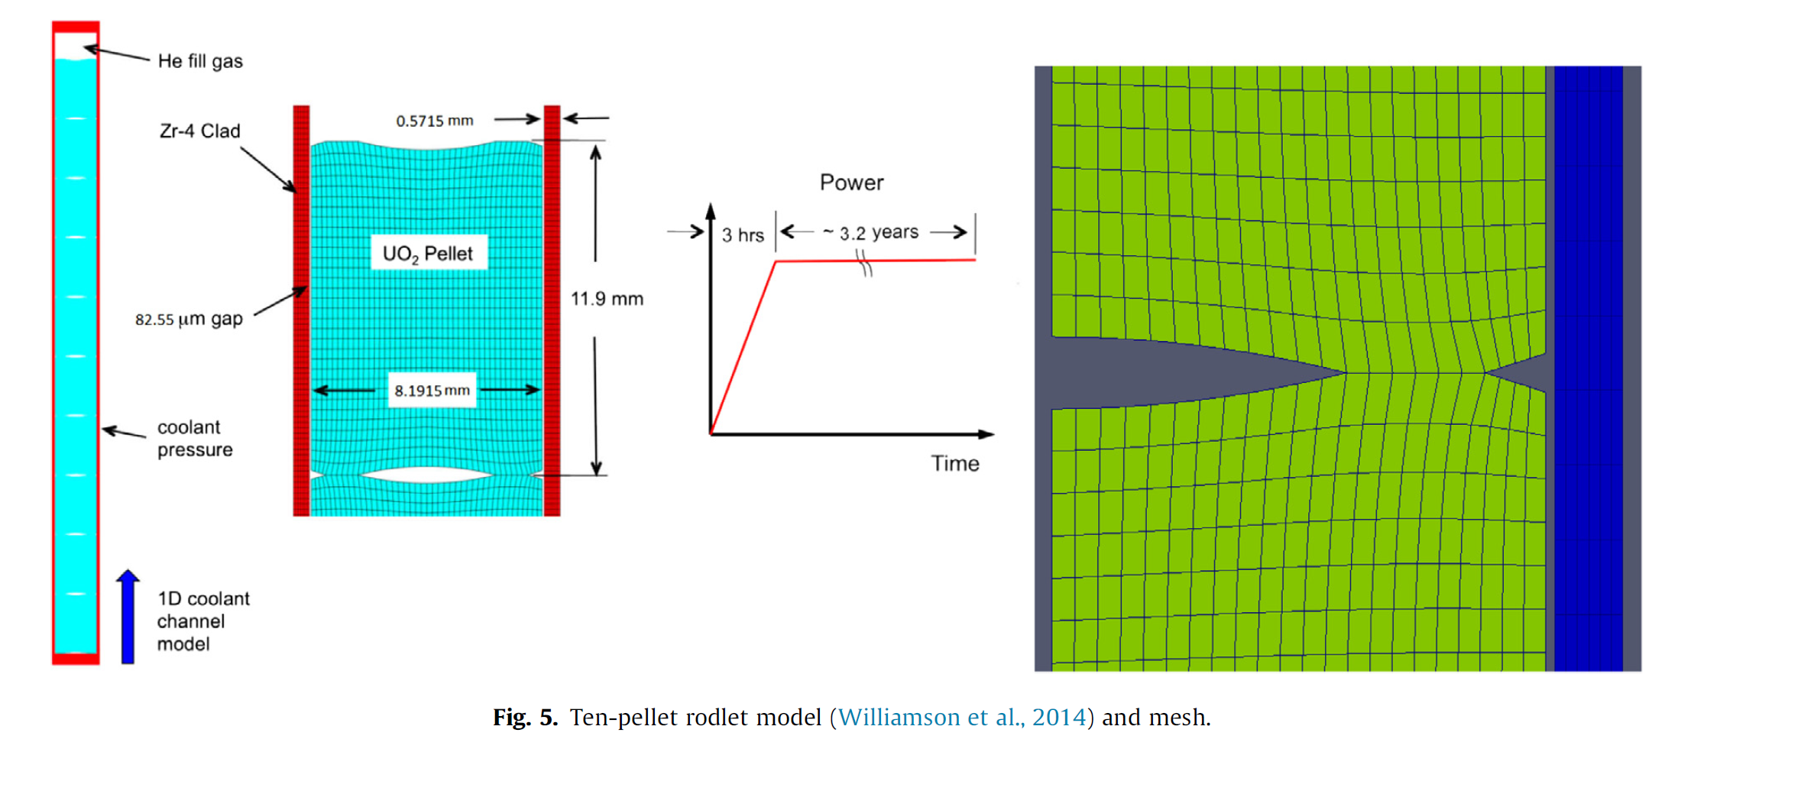
Fuel Performance Analysis Model.

Slide 13
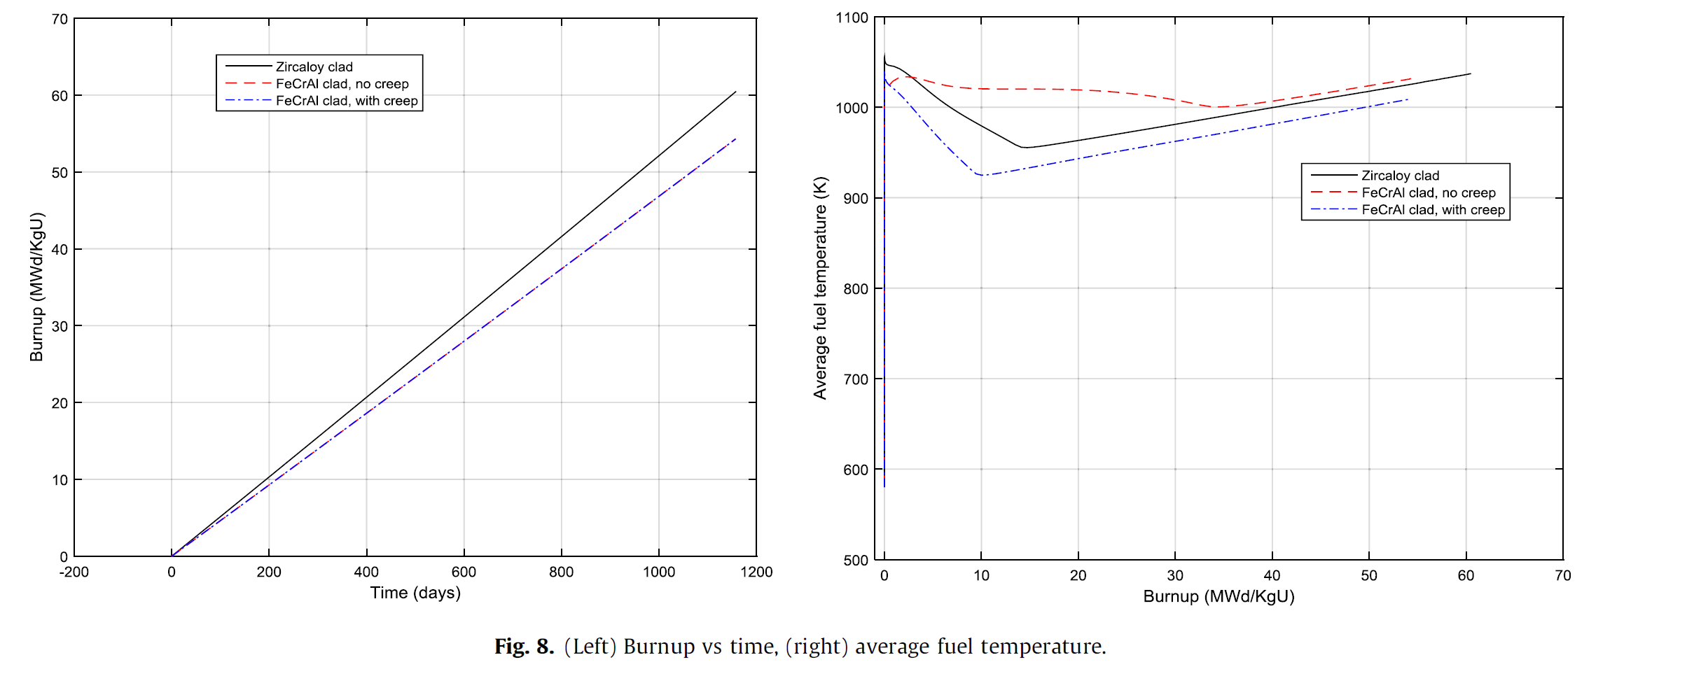
Burnup & Average Fuel Temperature
Because Fuel with FeCrAl has a slightly higher enrichment, the burnup at the same time is lower than fuel with Zircaloy cladding.
FeCrAl has similar thermal conductivity but much higher specific heat capacity compared with Zircaloy. This explains the lower average fuel temperature for FeCrAl with Creep.
Critique!!

Slide 14
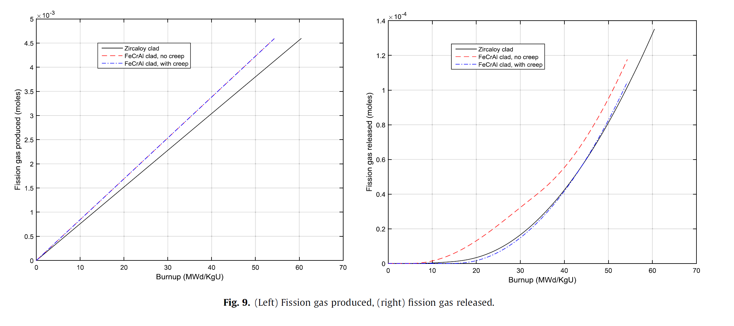
Fission gas produced & released
Both FeCrAl cases have lower burnup at a given time, they have higher fission gas production at a given burnup.
FeCrAl with no creep, higher temperature, higher gas release.

Slide 15
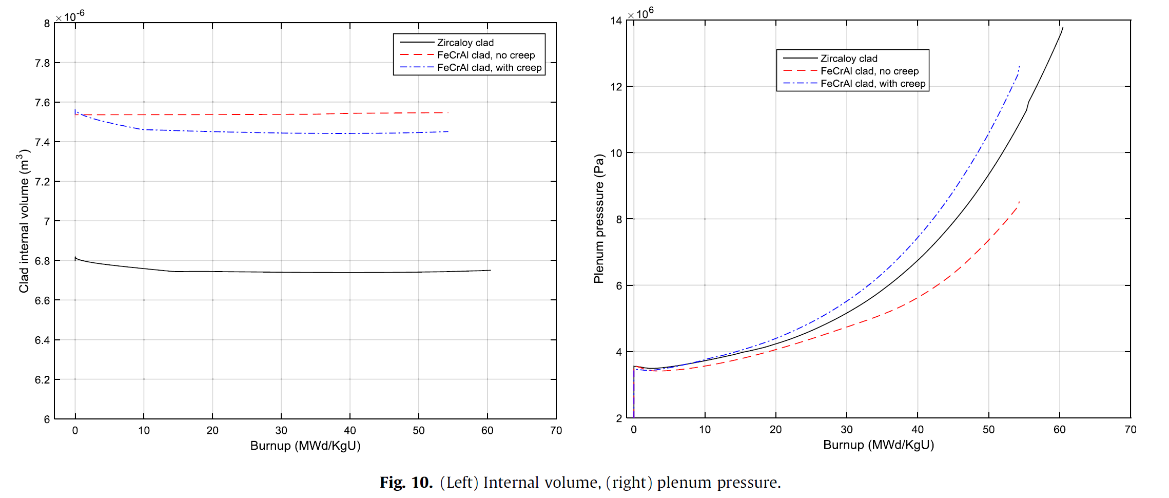
Internal Volume & Plenum Pressure
FeCrAl, smaller internal volume, larger gab.
FeCrAl+ no creep, nothing to compensate densification, higher temperatures, more fission gas release.

Slide 16
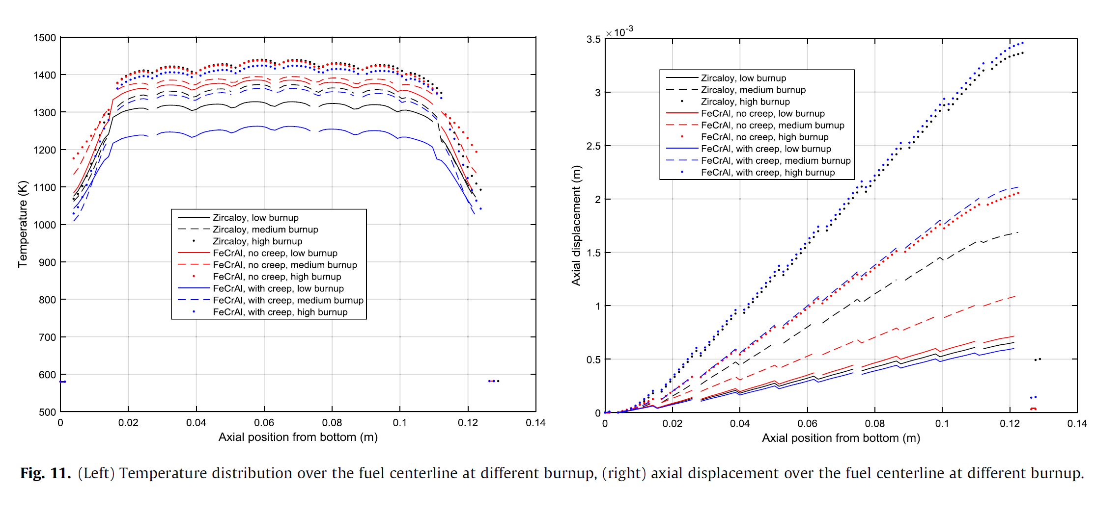
Axial Temperature and Displacement Distribution
With the increase of Burn up, the axial temperature difference decrease.
Axial temperature profile is flattened for FeCrAl with no creep
The displacement is lowest at medium to high burnup.

Slide 17
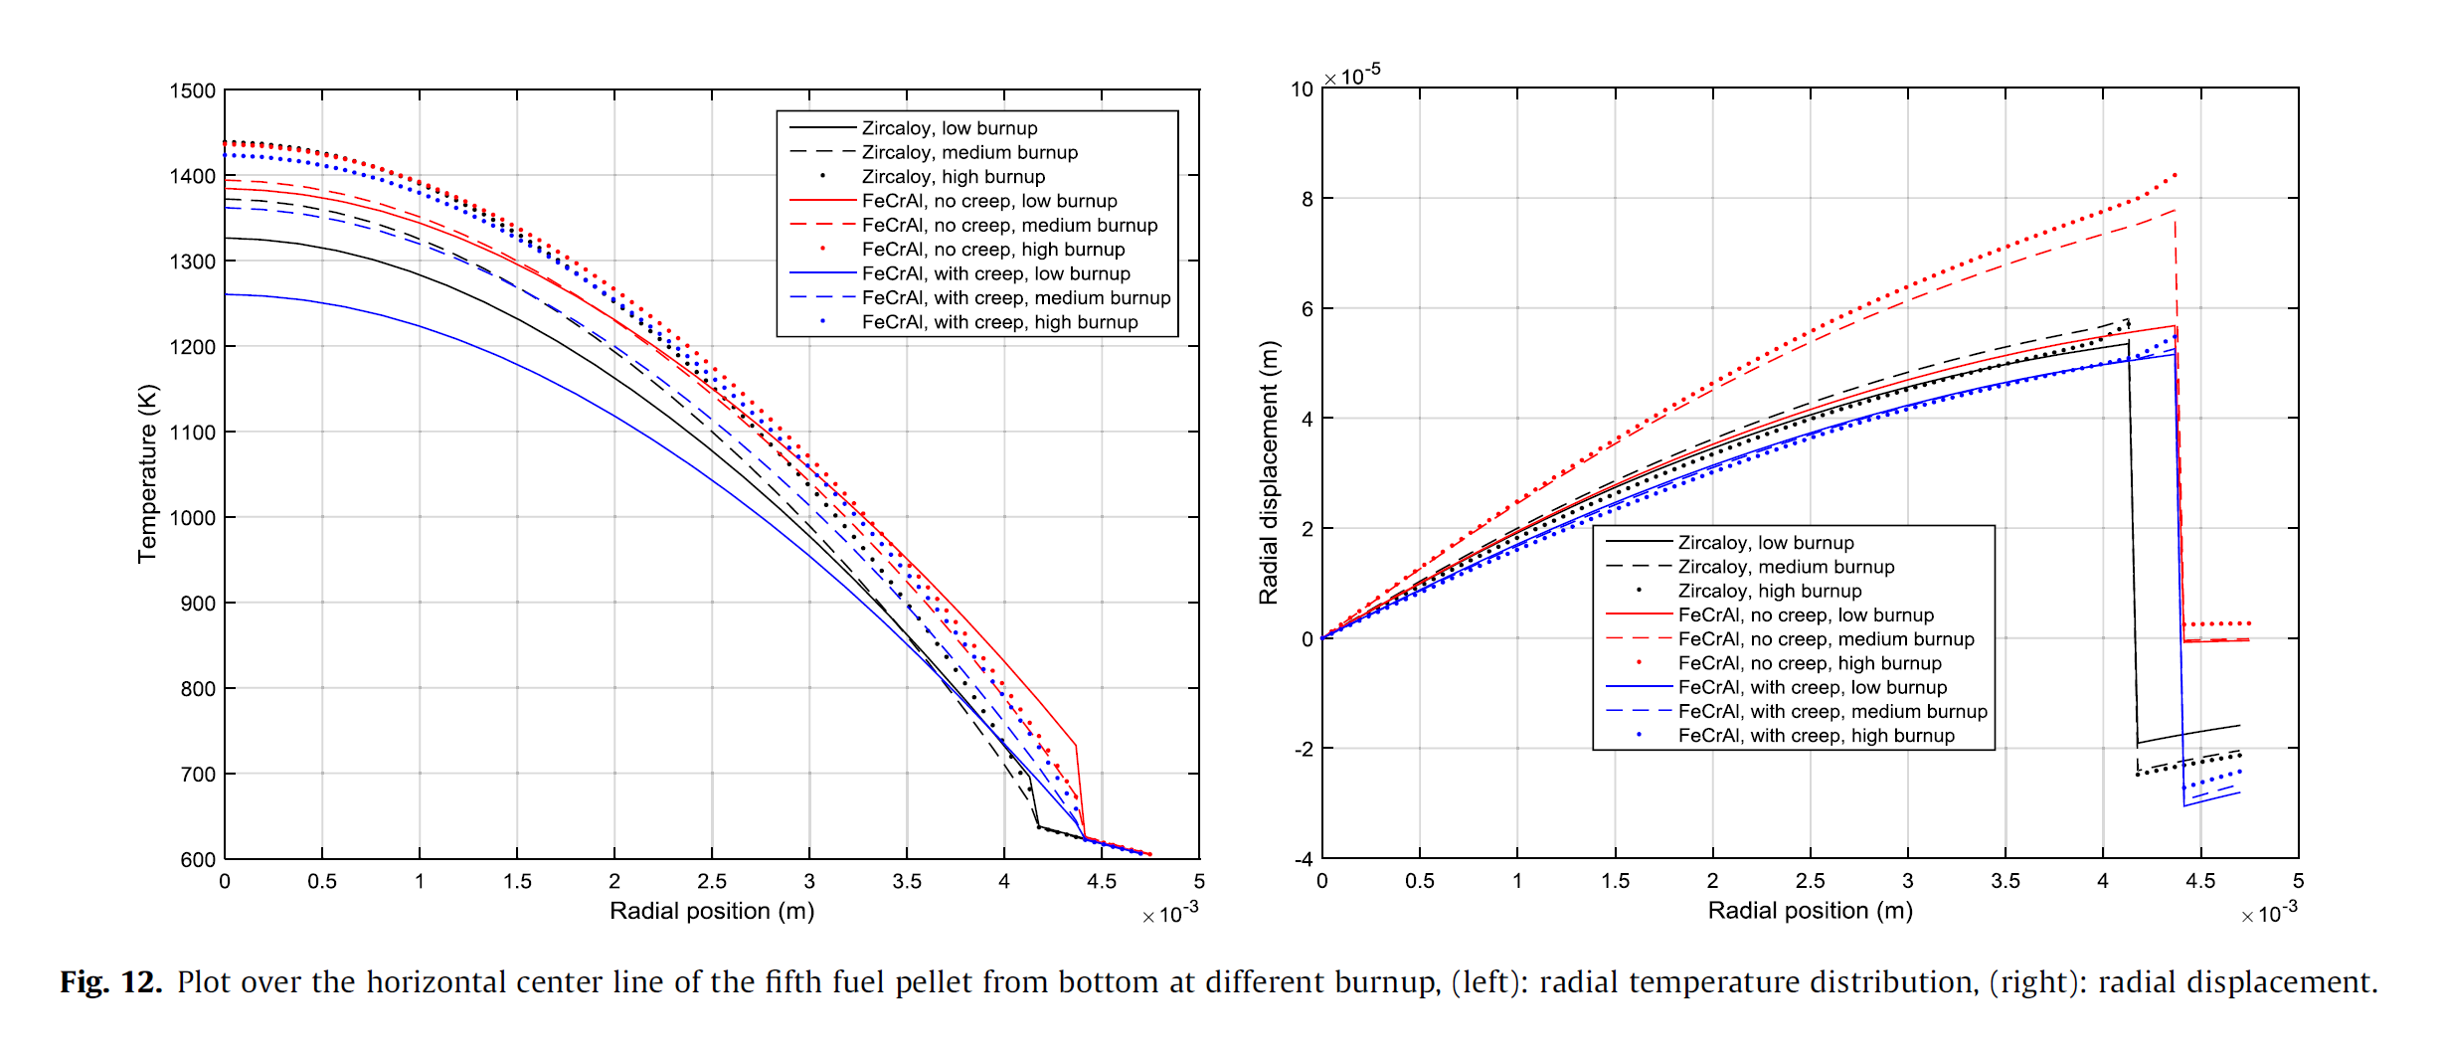
Radial Temperature and Displacement Distribution
Negative Radial Displacement.

Slide 18
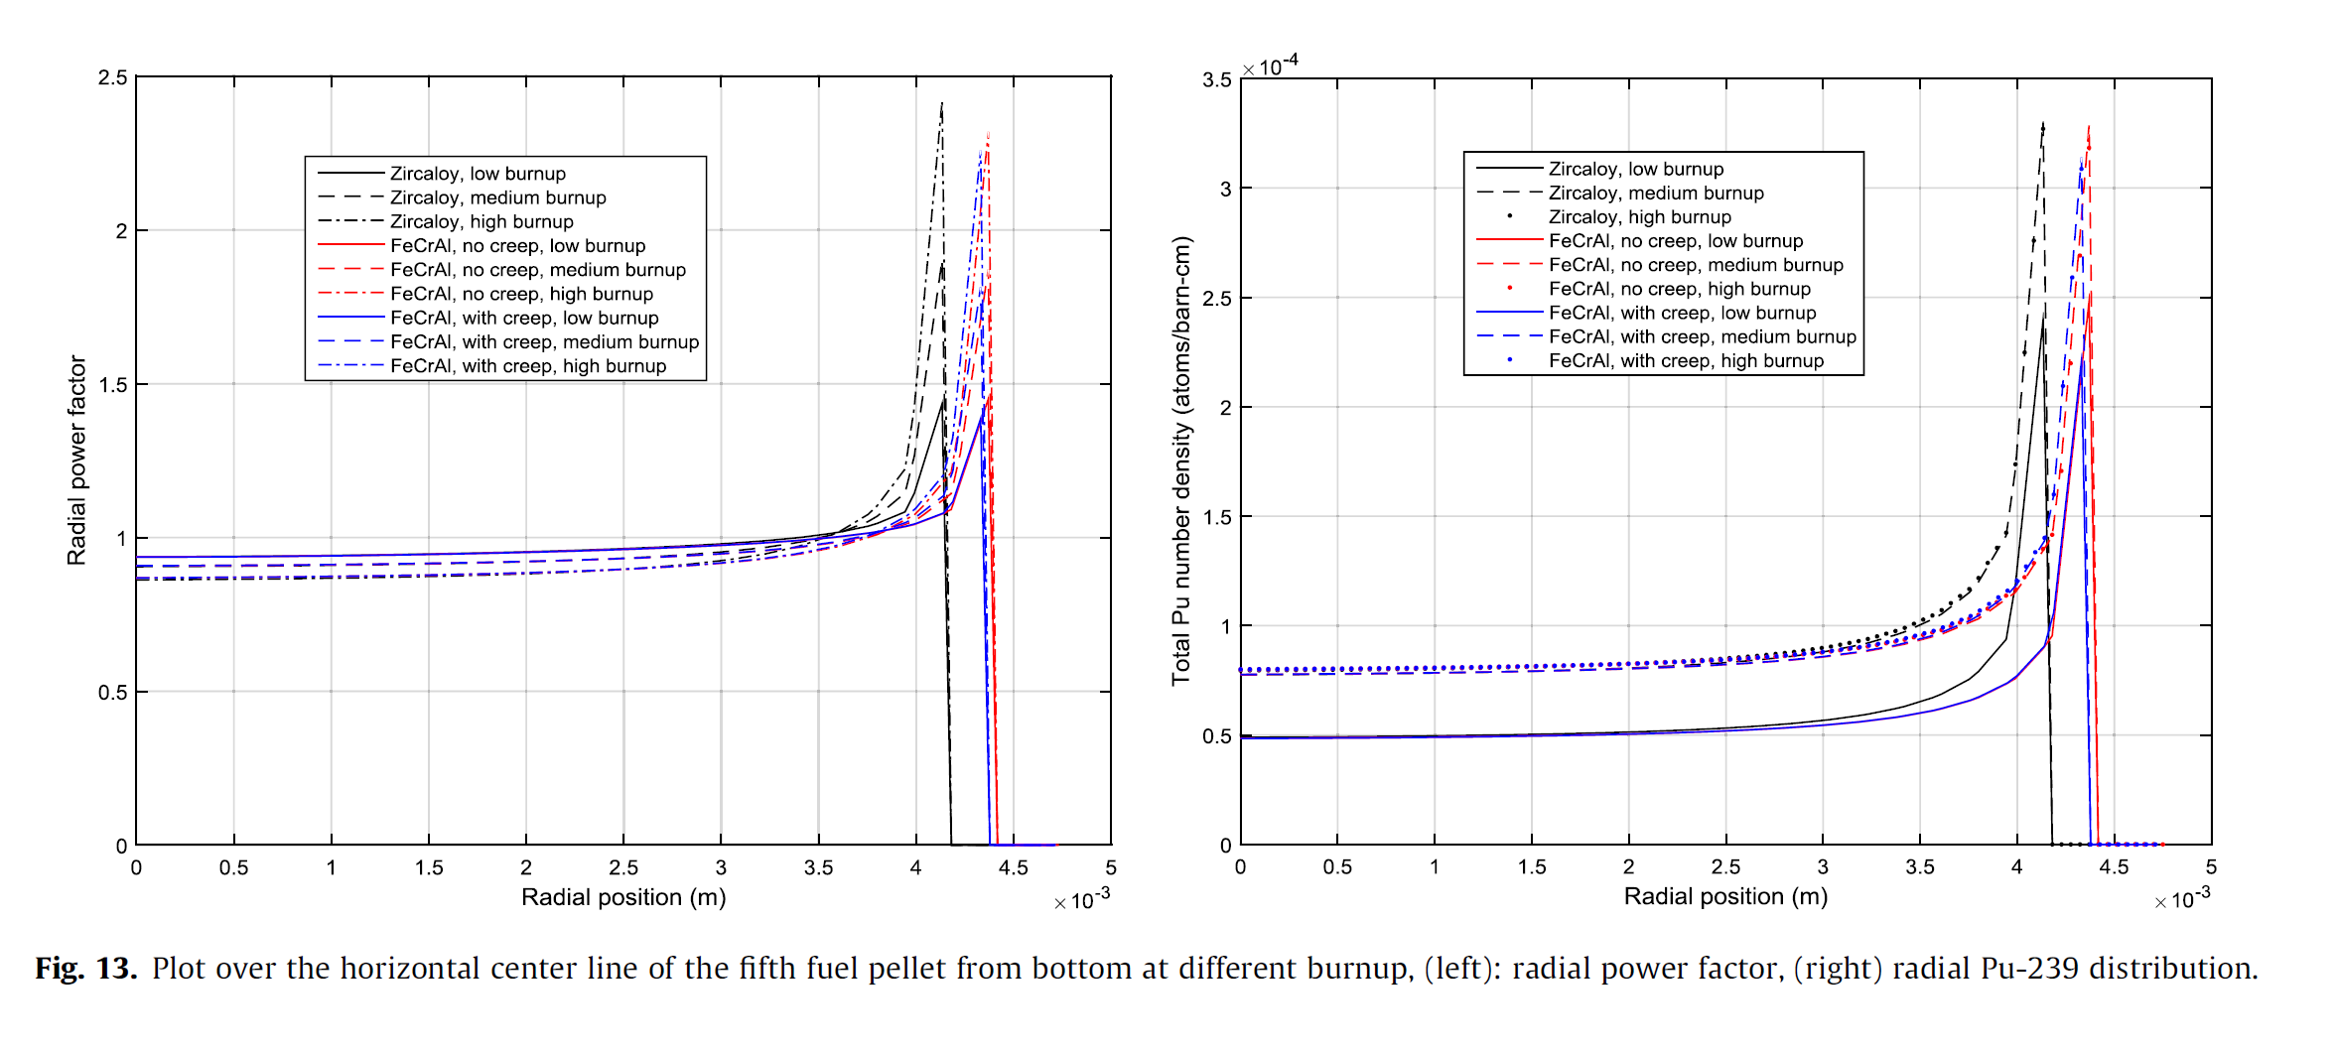
Radial Power Factor & Pu number density
Rim Effect.
Heat Generation and temperature distribution.

Slide 19
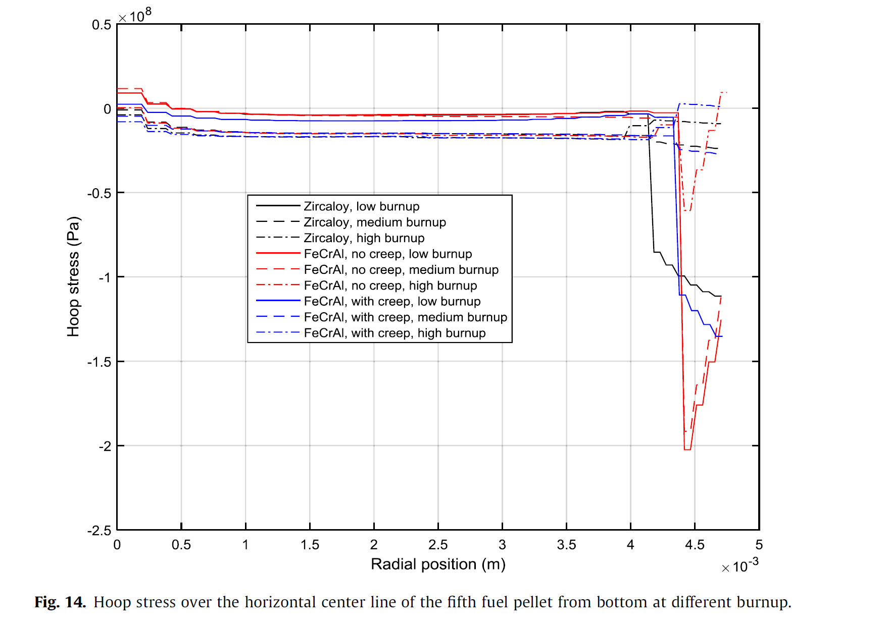
Hoop Stress
FeCrAl with no creep, has much larger hoop stress!.
Related to the creep behavior of the cladding!
Creeping inward, gab size decrease!
Critique!!

Slide 20
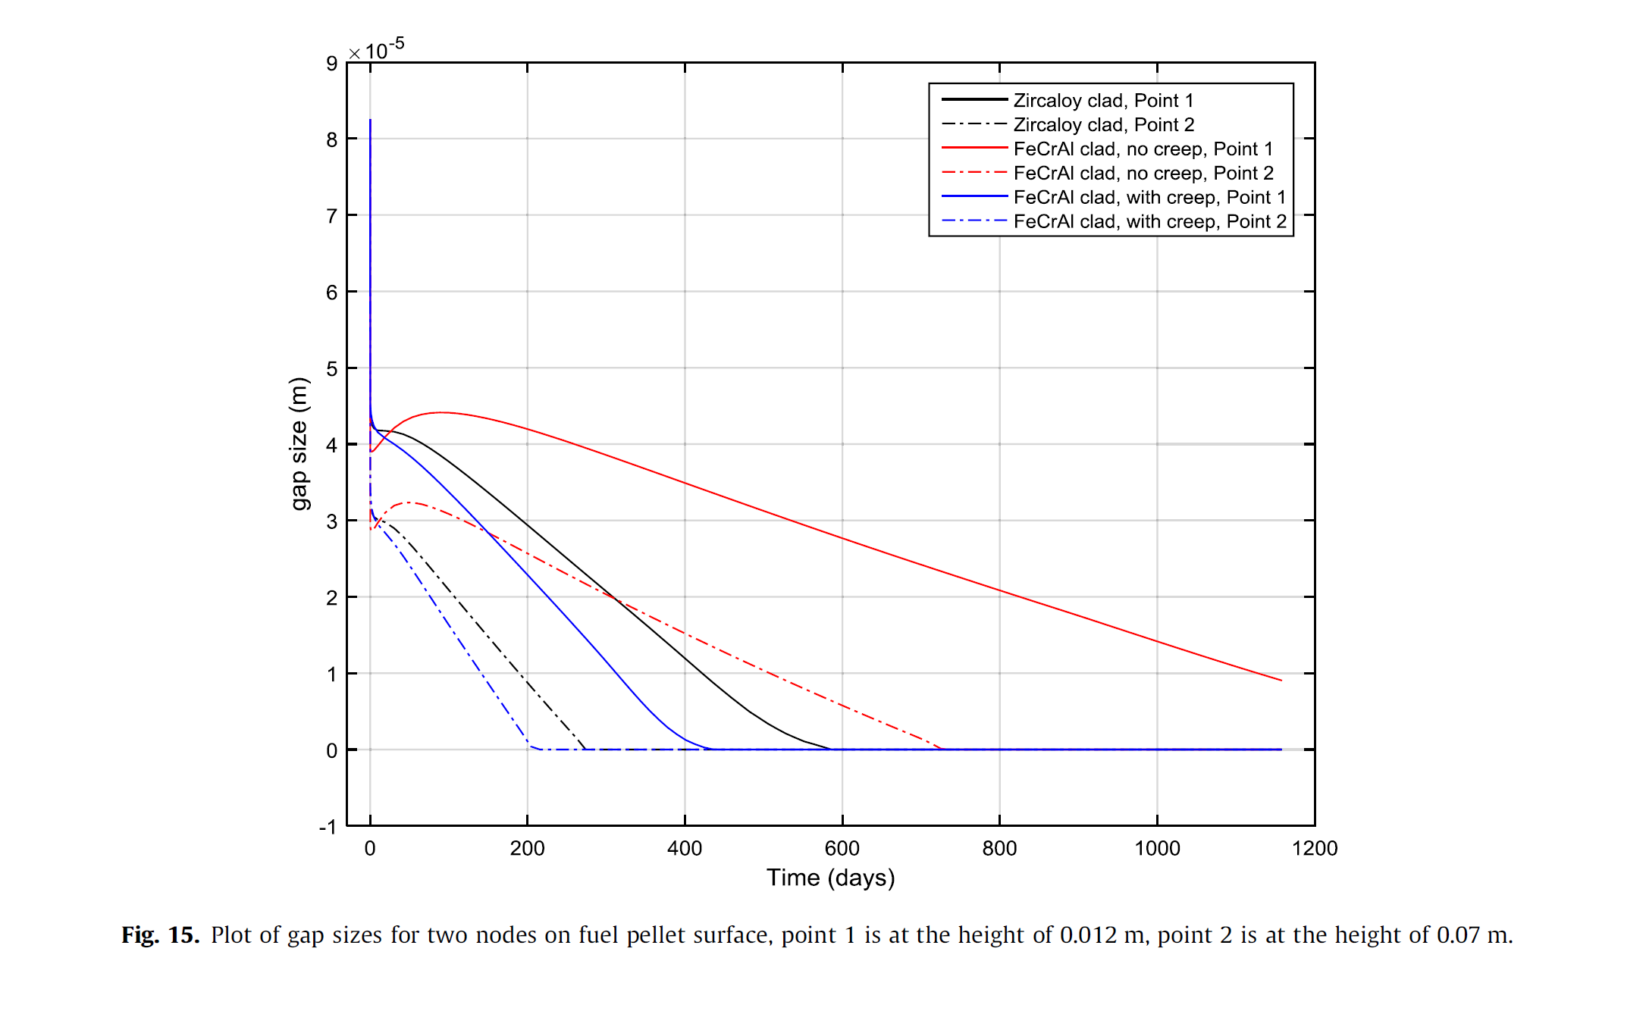
Gab Size
Two nodes at the pellet surface.
Point 1 is at height 0.012m. Center of first pellet.
Point 2 is at height 0.07m. Center of fifth pellet.
At the beginning, rapid decrease.
Fuel densification, swelling, thermal expansion and Creep.
Closure time for FeCrAl.
Critique!!

Slide 21
Questions ?

